Slide 1
THE GOSPEL

Slide 2
CHINESE WHISPERS
There are two ground rules when playing this game: 1. The message must be whispered.
2. The person hearing the sentence cannot ask questions, nor ask for it to be repeated.

Slide 3
Discuss
1. What was the sentence the first person passed on?
2. How did the final version compare with the initial sentence?
3. What happened to the sentence on the way around the circle?
4. What could be done to make sure the sentence was passed on with no variation?

Slide 4
From Oral to Written Tradition
The disciples of Jesus were busy going around preaching and teaching about Jesus because they wanted the people who came after them to know about Jesus. Many years after Jesus' death, people decided that the best way to ensure that Jesus' story would always be known was for themselves or close followers of Jesus to write it down.

Slide 5
Biography or autobiography?
Have you ever read a biography or autobiography?
Who could write a biography? When could a biography be written?
Why do people write biographies?
Who is the intended audience for a biography?

Slide 6
There are three stages involved in the writing of a biography or autobiography:
· The events that the person is involved in, take place
· These events etc. are reflected upon or researched
· The actual writing of the words and putting together of the story
The Gospels tell the story of the life death and resurrection of Jesus. They are quite like a biography that you would read about any famous / important person, except they are not as interested in giving historical facts about Jesus, as they are in giving an account of the meaning of his life, death and resurrection.

Slide 7
Who wrote the Gospels?
When were the Gospels written?
Why were the Gospels written?
Who are the intended audience for the Gospels?

Slide 8
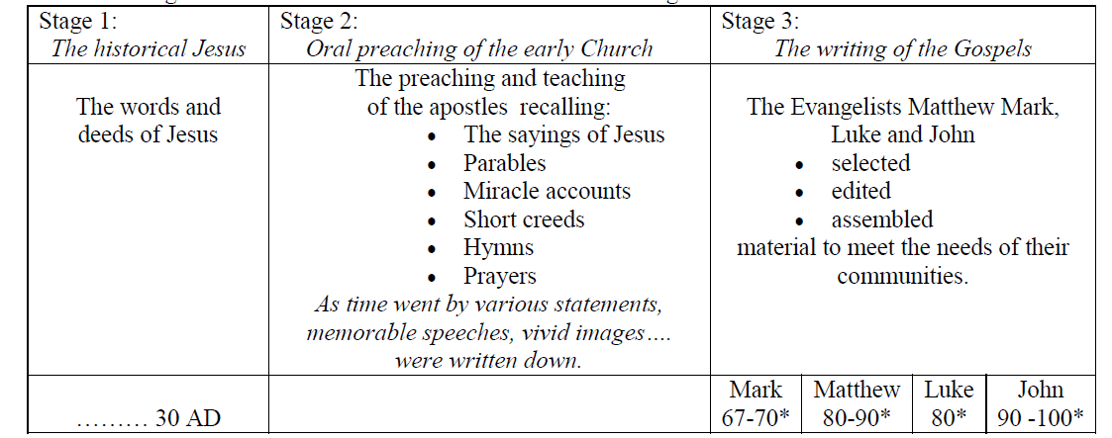
Notes:
As with the writing of a biography there were a number of stages in the development of the Gospels.
Scripture scholars generally recognise that the Gospels were developed in three distinct stages. They are the
result of a somewhat gradual process of formation and composition.

