Slide 1
Sign and Symbol
Miss McKenna

Slide 2
SIGN

Slide 3
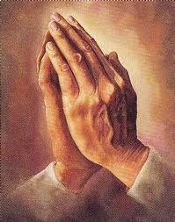
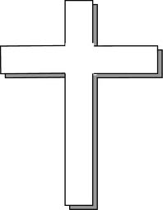
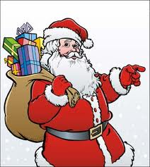
SYMBOL

