Slide 1
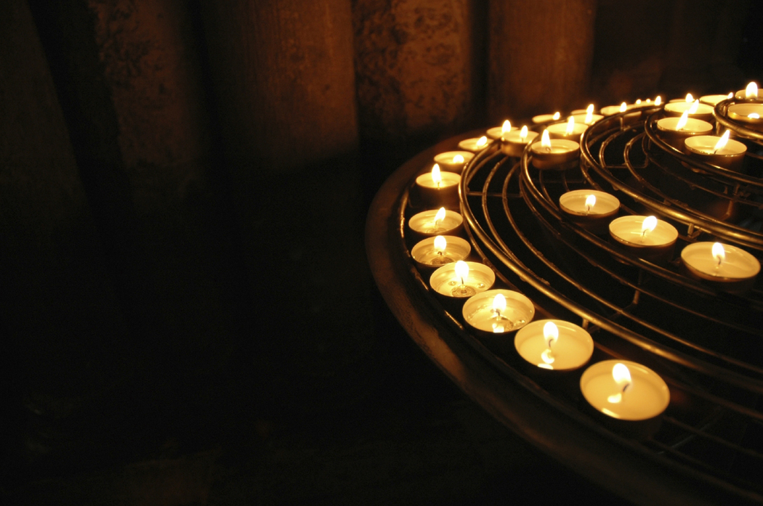
Religion in a Changing World.
In the past, Irish Catholics expressed their faith by regularly attending Mass and the sacraments, and participating in the following devotional practices:

Slide 2
The Rosary

Slide 3
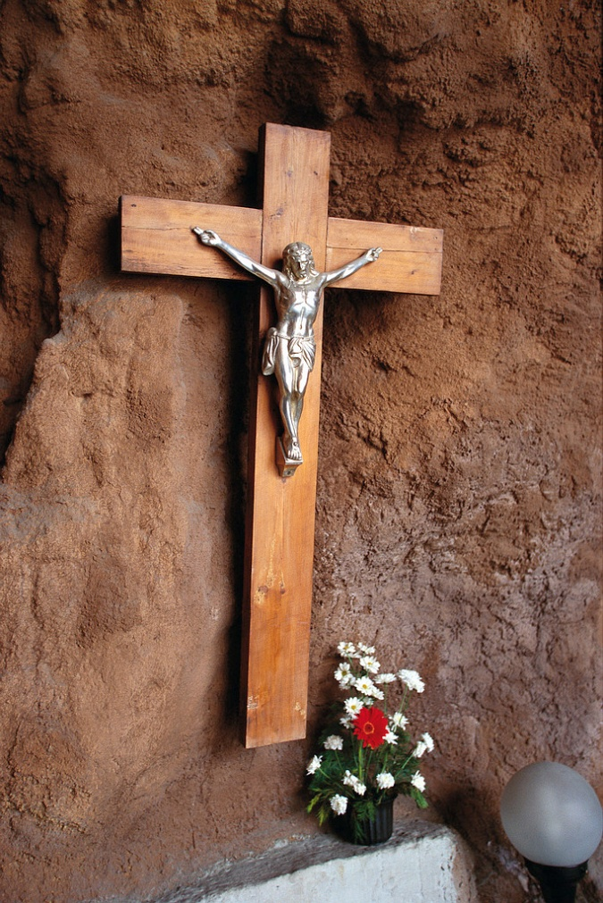
Stations of the Cross

Slide 4
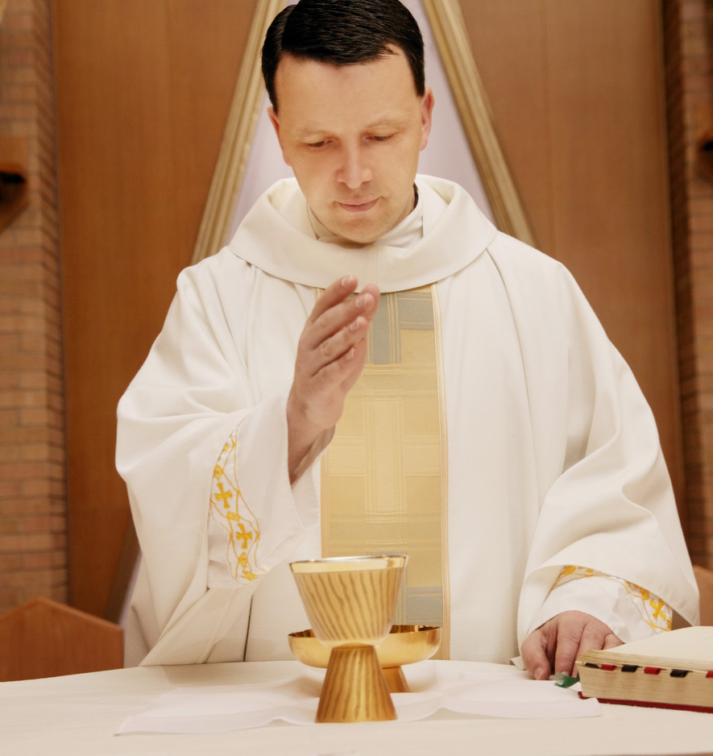
The Stations

Slide 5
The Angelus

Slide 6
Benediction

Slide 7
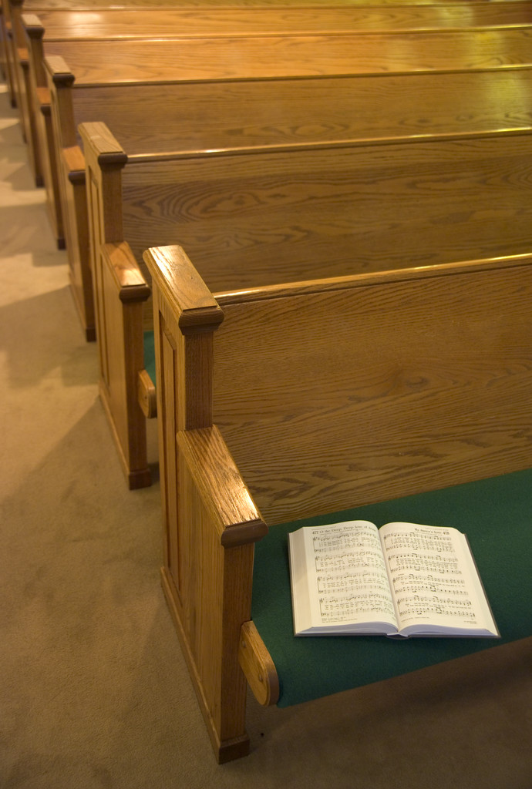
The Parish Mission

Slide 8
Factors that caused
a change in Mass attendance
and devotional Practice:
1. The influence of the huge movement of people from the countryside to towns and cities in search of work. This led to a decline in religious practice in rural areas.
2. The influence of film and media. They presented images, values and behaviour that were different from people’s religious values and way of life.
3. The influence of economic prosperity. People work longer ours and may not have the time, energy or inclination to practice their faith.

Slide 9
The Second Vatican Council
… a meeting of 2,600 bishops in Rome from 1962 – 1965. It has had an enormous influence on the religious practice of Roman Catholics in the last fifty years.
Mass in English
Priest faces congregation
Female Altar Servers
Changes to the Church

Slide 10
The Pope and the Bishops worked together to find new ways of bringing the teaching of Jesus closer to people in the modern age.

Slide 11
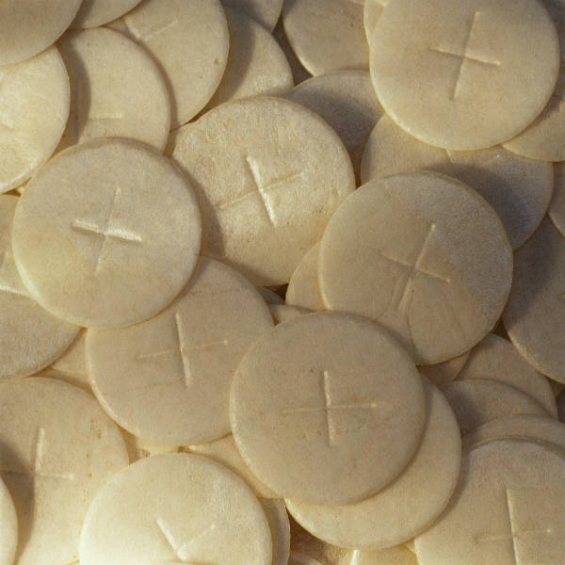
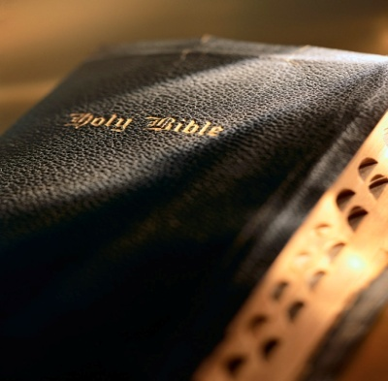
Role of Lay People
The role of lay people in the Catholic church was greatly increased to help them feel more connected to the Church.
Ministers of the eucharist
Ministers of the word
Liturgy preparation &
Parish councils.

