Slide 1
Moral Decision-Making

Slide 2
Moral decision making...
Morality means....
Value
Quality of human acts
A guide
Right vs Wrong

Slide 3
Conscience

Slide 4
Conscience
Capacity
Process
Judgement

Slide 5
Fun time☺
QUICK FIRE QUIZ...
ANSWER IMMEDIATELY!!!!!!!!!!!!!!!!!!!!!
Can you see how some decisions are made immediately as they do not have a major influence or effect on one’s life.
Others require greater consideration.

Slide 6
Moral Decision Making
Moral decision making refers to the decisions which require greater examination and searching than others, in order to discover what is right and good, and what is true- in accordance to a person’s moral vision and outlook on life

Slide 7
Moral vision...
To have a moral vision is to have a certain outlook on life, yet it is somewhat more than that. It is a way of seeing what is right and wrong, what is fair and unfair,. This outlook has a powerful influence on the choices we make. It is the background to all our moral decisions and actions.
Having a moral vision shapes the way we behave morally.

Slide 8
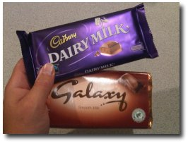
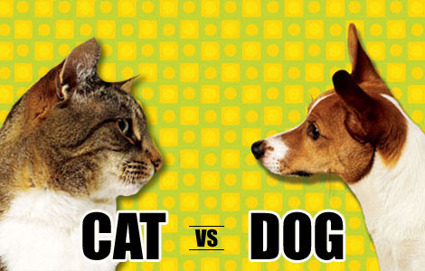

Slide 9
L.I.S.T.E.N.
N
ame your decision
E
xpect God’s help
T
urn inwards
S
eek insight beyond your own
I
magine the possibilities
L
ook for the facts

Slide 10
Moral Decision Making in 'The Simpsons'
http://www.gametrailers.com/videos/ltpda5/simpsons-bart-steals-a-video-game

Slide 11
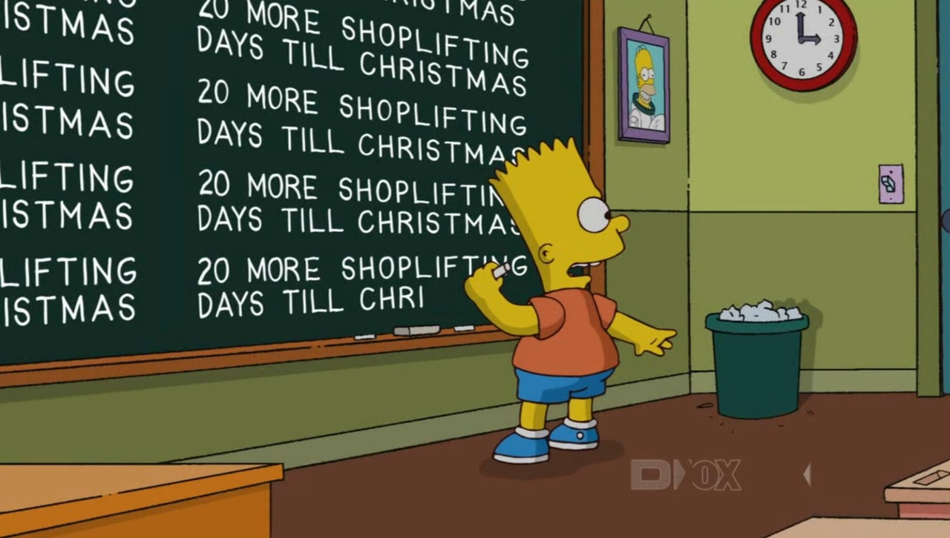
L – Look for the facts
L – Look for the facts
Bart wants a video game.
Bart doesn't have the money for it.
His peers stole from the shop.

Slide 12
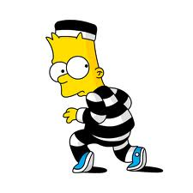
I – Imagine the Possibilities
What would happen if :
Bart took the video game?
Bart took it and got caught?
Bart took it and didn't get caught?
Who would be affected by Bart's decision?
What would be the impact of Bart’s decision?

Slide 13
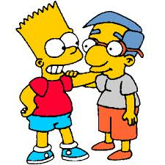
S –Seek insight beyond your own
Whom should Bart talk to?
What will he say?
What would his family, friends, community and faith say?
Would they all say the same thing?

Slide 14
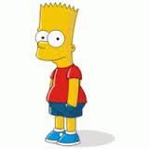
T – Turn Inwards
Bart has to listen to his conscience.
Bart would not have been allowed into the shop if the shop had thought he could not have been trusted.
If he makes a quick decision, it could have devastating consequences and affect his reputation for a very long time.

Slide 15
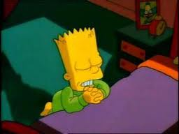
E – Expect God’s help
At this point, Bart needs take time out to pray for guidance.
Bart could examine scripture and other religious sources.

Slide 16
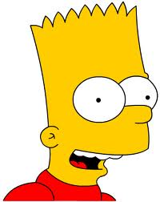
N – Name your decision
This means coming to a clear decision after reflection.
It is important to complete each stage in the process and be happy with your decision before acting on it.
At this stage, Bart must make a decision and be happy with it.
He must act on it.

