Slide 1
Jewish Religion
Places of Worship at the time of Jesus

Slide 2
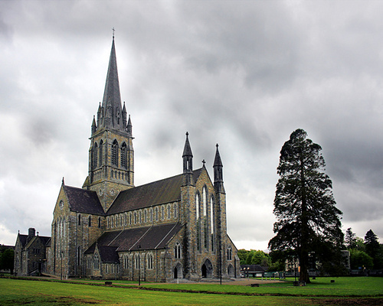
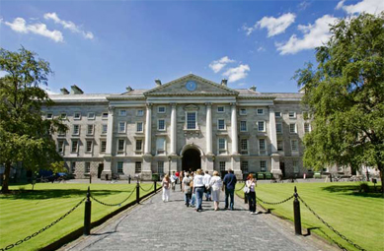
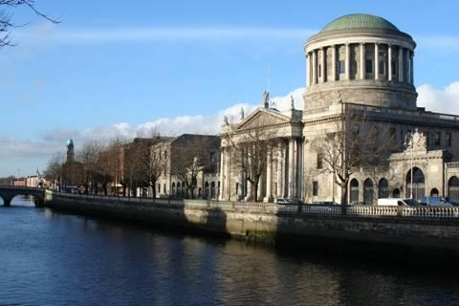
“Amazing places”
We are surrounded by buildings of all shapes and sizes. If we stop to think about it, some of them are quite impressive, even the older ones.
What is the most awesome place you have ever been in?
What was it like?
What happens there?

Slide 3
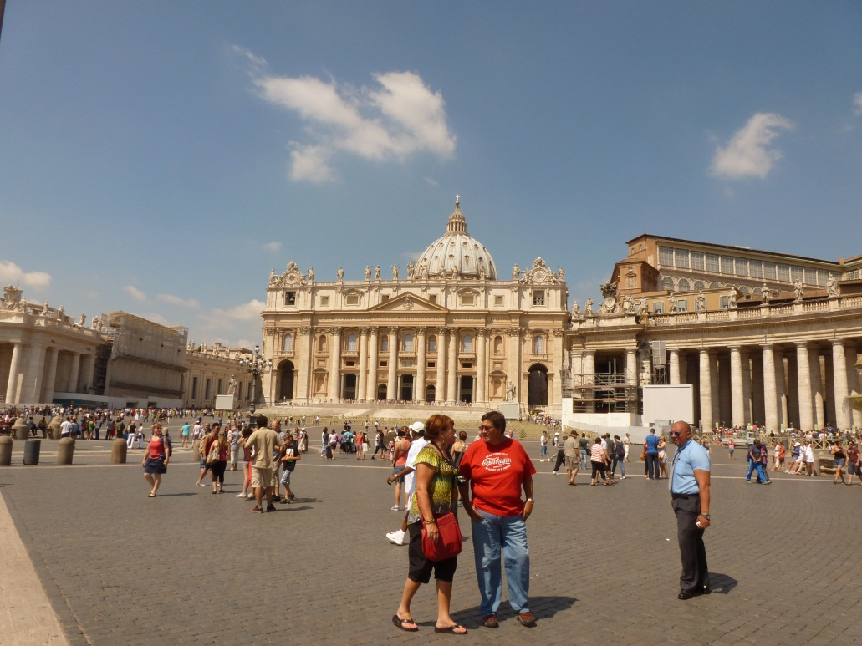
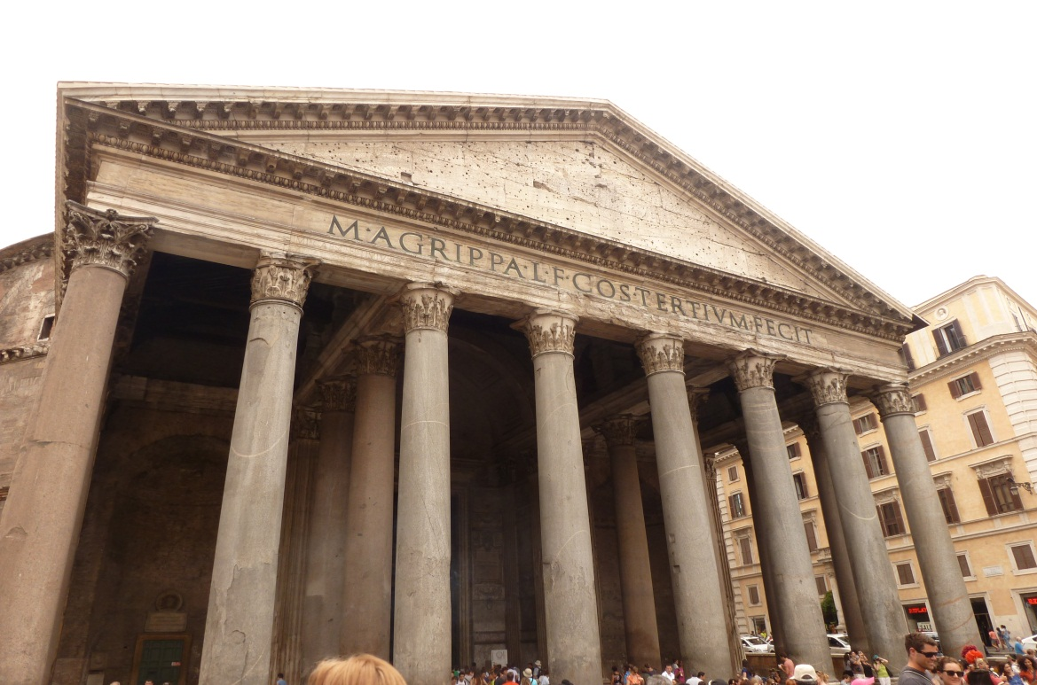
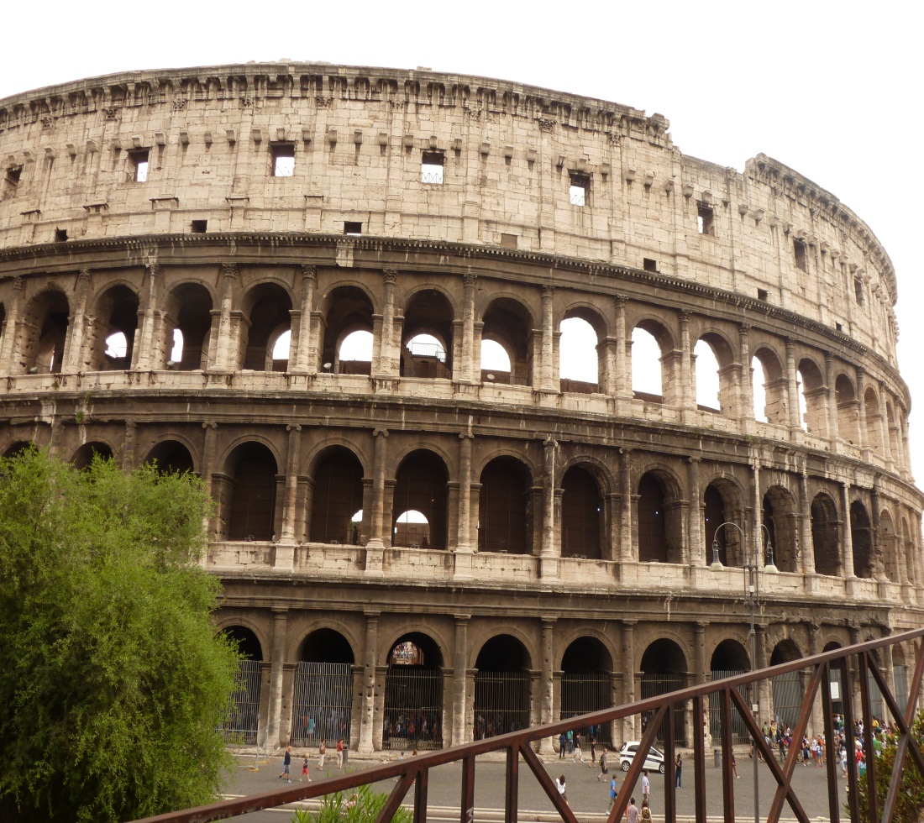
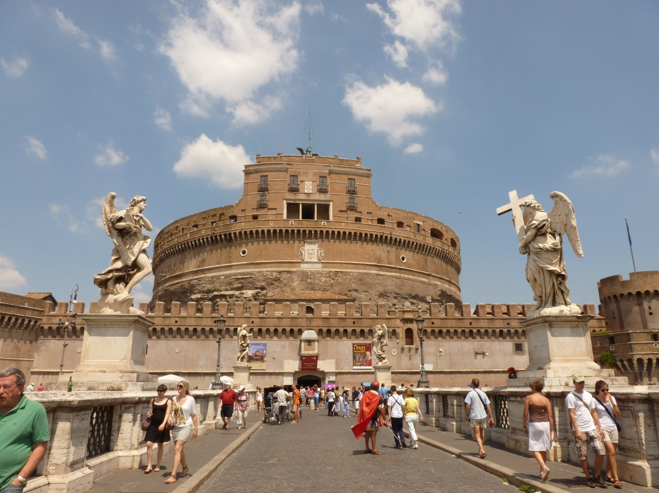

Slide 4
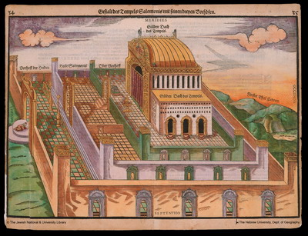
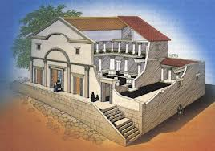
Ancient Judaism
The Temple in Jerusalem
The Synagogues
Notes:
Synagogue – probably represent the synagogue at Capernaum. The men met in the inner room and the balcony was the place for women.

Slide 5
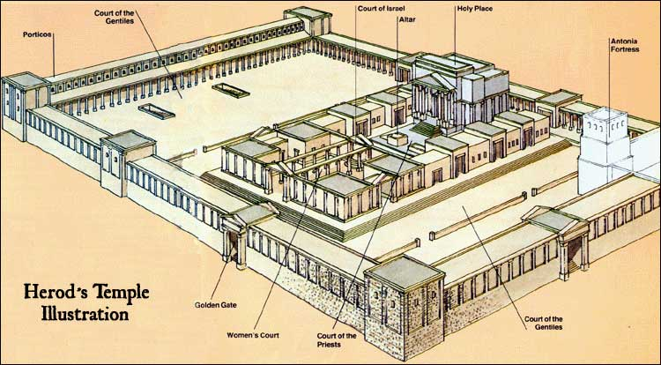
Notes:
The Temple in Jerusalem was a magnificent building. It was very large and could hold several thousand people. The temple was probably the biggest building most people had ever seen. It was very ornate inside and out. The walls and pillars of pale stone were covered in gold. The temple was a sacred building. Jews believed it was a dwelling place of God. It was built originally to house the ark of the covenant, a chest containing the stone tablets on which the Ten Commandments were written. Jewish families went to the temple once a year, on the feast of Passover, to pray and offer sacrifice to God. The temples courtyard was a market place called the Court of Gentiles. It was here that Jewish Pilgrims changed their Roman coins into Temple currency and bought birds and animals for sacrifice. The temple priests took these offerings and sacrificed them on the altar in the courts of the priests. The most important part of the temple was the Sanctuary. Inside there was a special place called the Holy of Holies. A large curtain covered it’s entrance and no one, except the High Priest, was allowed to enter. He went inside once a year to offer sacrifice to God and to pray for forgiveness for all the people. The temple in Jerusalem was destroyed by the Romans in 70CE. Part of one wall is all that remains. It is the holiest place in

Slide 6
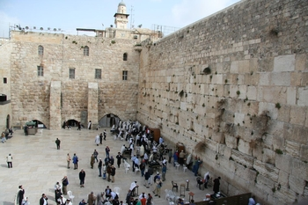
What is the name of the remaining wall of the Temple?

Slide 7
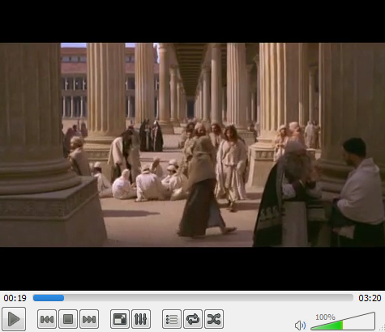
Questions on video!
What were the people doing in the temple?
Why was Jesus angry with the people in the Temple?
How long did the Temple take to build?
What temple was Jesus speaking of when he said he would rebuild the temple in three days?

Slide 8
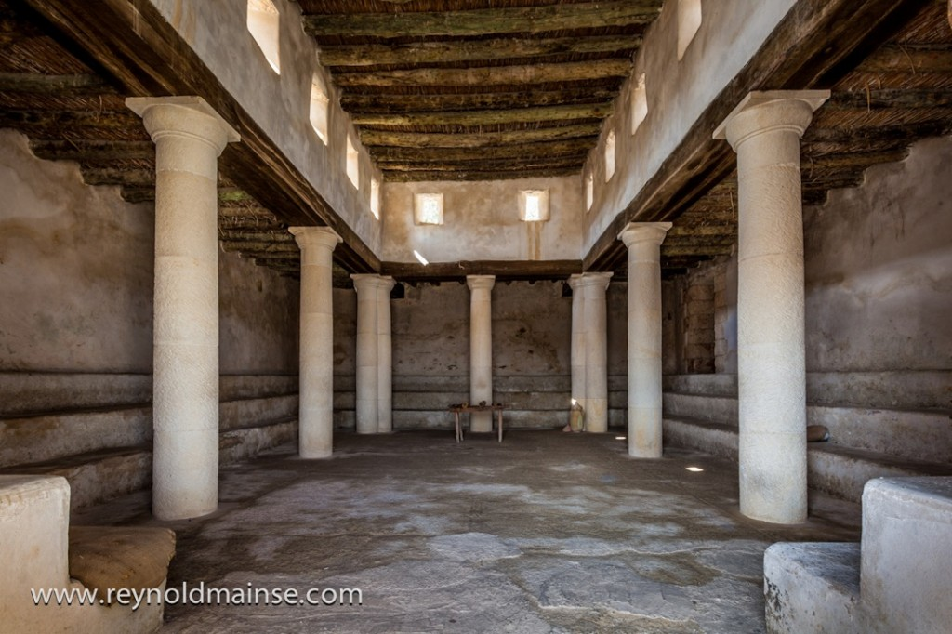
Synagogue
Synagogue – what it would have looked like at the time of Jesus.

