Slide 1
The Holocaust

Slide 2
Elements Leading to the Holocaust
History of Anti-Semitism
Totalitarianism combined with Nationalism
Defeat in World War I
Hitler’s belief in the Master Race
The Final Solution

Slide 3
Anti-Semitism
Hostility toward or discrimination against Jews as a religious, ethnic, or racial group.

Slide 4
Laws affecting Jews in Germany under National Socialism
Following the National Socialists rise to power in 1933, anti-Jewish laws and practices became common in the Reich. Such laws included: - Jews were subject to curfew. - Jews were forbidden to buy newspapers - Jews were not allowed to practice a number of professions such as law, education, medicine.

Slide 5
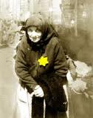

Slide 6
Final Solution
Ghettos
Camps
Transportation
Gas Chambers
Crematories

Slide 7
Ghetto
An area within a city that all Jews were forced to live.
Food rations and living conditions were very poor.
Major Ghettos
Warsaw
Lodz
Kovno

Slide 8
Transportation
Systematic Deportation
Boxcar
100+ people in one car
Doors were bolted shut
No place to sit down
Often people were forced to pay for their transportation
No food or water given.

Slide 9
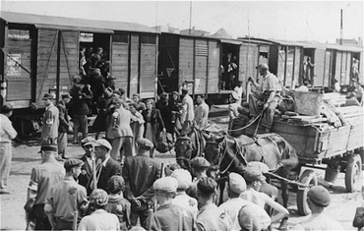

Slide 10
Concentration Camps
Types of Camps
Concentration/Labor
Extermination/Death
Major Camps
Dauchau-Buchenwald
Auschwitz
Treblinkia
Bikenau
Notes:
Types of Camps
Concentration camps
Forced labor
Life in the camp was terrible
There was overcrowding
Low food rations
Prisoners underwent interrogations to discover and information
Cruel medical experiments conducted

Slide 11
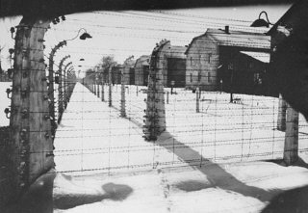

Slide 12
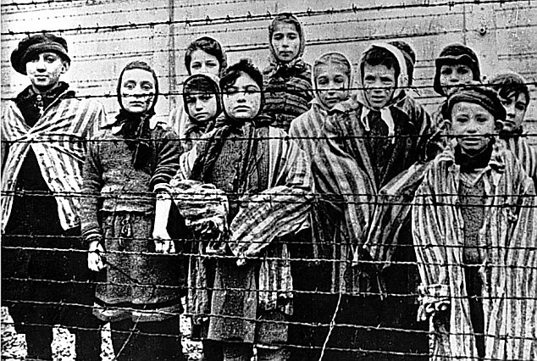
Notes:
http://www.telegraph.co.uk/history/world-war-two/8940001/Germany-to-give-Holocaust-victims-pensions.html

Slide 13
Gas Chambers
Many victims did not know of their death
Gas Chambers were referred to as Baths/Showers
Zyklon B – was used as a poison
Millions of people came to their deaths.

Slide 14
Crematoriums
Prisoners were forced to staff the crematoriums.
Their job was to remove all valuables from the victims.
Click here to watch a
Survivors Testimony…
Notes:
http://www.ushmm.org/wlc/en/media_oi.php?ModuleId=10005145&MediaId=1080

Slide 15
Questions on video!
What does the word Holocaust mean?
Why did the director decide to do this documentary?
Where was Joe Engel born? What year did he go to Auschwitz?
What happened to Pincus Kolender’s mother?
Do you know why he has a number tattooed on his arm?

Slide 16
The UN General Assembly designated January 27—the anniversary of the liberation of Auschwitz-Birkenau—as International Holocaust Remembrance Day. On this annual day of commemoration, every member state of the UN has an obligation to honor the victims of the Nazi era and to develop educational programs to help prevent future genocides. This year’s theme is Rescue during the Holocaust: The Courage to Care.
Notes:
httwww.ushmm.org/museum/exhibit/focus/ihrd/video/p:// http://www.ushmm.org/wlc/en/media_oi.php?ModuleId=10005131&MediaId=1100

Slide 17
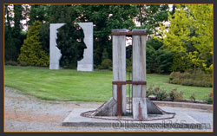
Memorials
The only public Holocaust memorial in Ireland, is in the Garden of Europe in Listowel, County Kerry.
Notes:
http://www.rte.ie/player/ie/show/10104861/

